Slide 1
2022
Business plan

Slide 2
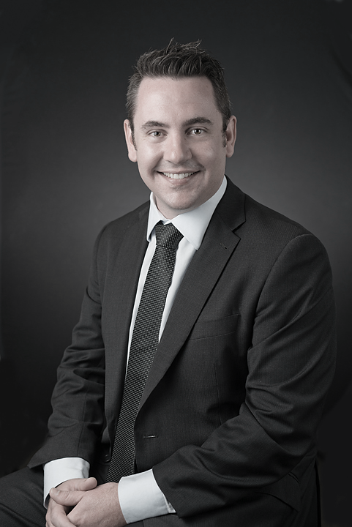
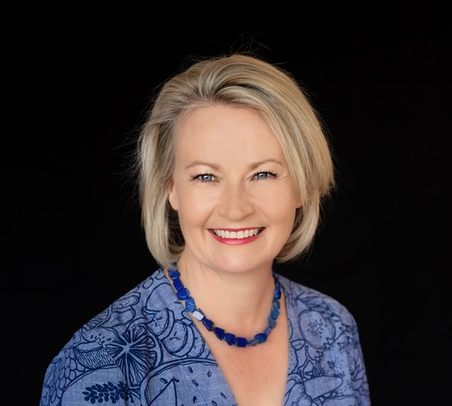
Chair’s Message
CEOs Message
A big welcome to all our members for 2022.
I’m sure like many of us, I truly believe that there has never been a more exciting time to be working in infrastructure in Queensland; across transport, utilities, education, health and digital – we are continuing to deliver significant economic and social transformation for the betterment of our communities.
Just over the horizon, there is greater opportunity coming; emerging technologies, changing consumer needs and global economic shocks will continue to disrupt the familiar operating and business models of the past layering deep complexity and uncertainty in our future infrastructure decisions.
In these environments, flexibility, innovation and collaboration will drive new models of service delivery, products and services that work together in a wider ecosystem that blends both private and public for the greater good. As industry leaders it will be increasingly important to embrace both agility and adaptability in all we do.
The IAQ has for the better part of 28 years, worked hard to provide members a consistent voice in infrastructure and I look forward to working with our members and our wider infrastructure stakeholders in responding to the challenges and importantly, the opportunities ahead.
Jon Frew - Chair
A powerful, considerate and considered voice for our Members and stakeholders.
Rich and extraordinary opportunities abound in Queensland this is the right State at the right time to be in infrastructure – on the global stage in so many ways!
For many of us though, we are starting 2022 tired and incredibly busy. Delivering work, trying to win work, find and hire people, look after our staff and our families, while adjusting our operating models to suit a rapidly changing world. Its exhausting stuff.
We need to balance how the Queensland infrastructure industry, in all its diversity, capitalises on this moment in time to lead a sustainable transformation uniting the private and public sectors, for generational better outcomes, which will directly benefit the communities and businesses we deliver for. Doing so, while, supporting the health and wellbeing of our people and attracting new people to our industry.
This is no easy task, but its going to be an incredibly rewarding one.
IAQ will be laser focussed on leading the transition sustainability and providing support to our members as we go on this incredible transformation journey together, helping our industry be exceptional.
Priscilla Radice – CEO

Slide 3
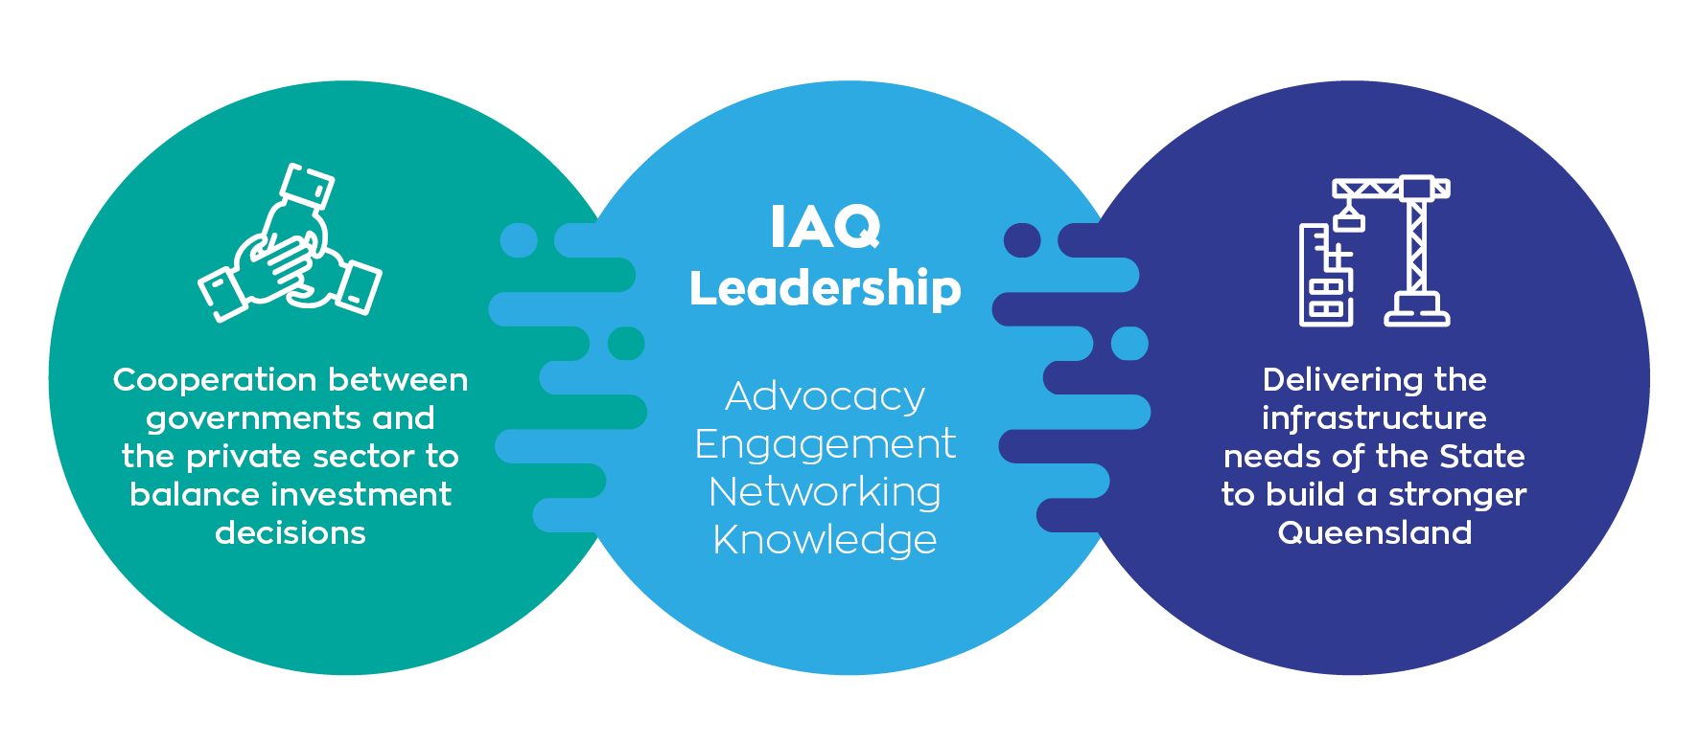
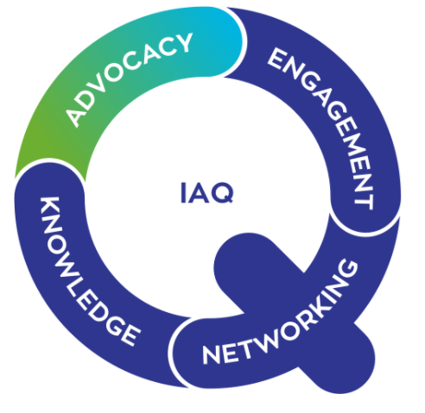
Our purpose
IAQ focuses on fostering cooperation between governments and the private sector to collectively build a stronger Queensland through the understanding and delivery of infrastructure needs for the community. Infrastructure by its very name is the spaces between – we create a social system.
We bring our members closer to their clients and peers and provide an opportunity for you to shape our industry now and into the future. We achieve this in four ways: Advocacy, Engagement, Networking and Knowledge.

Slide 4
2022
KEY PRIORITY AREAS
As directed by the Board, IAQ will continue to build on the success and momentum of 2021, delivering on the following key priorities:
Enabling a vision for QLD
Working with other industry leaders and influencers to collectively develop an infrastructure vision for Queensland
Delivering better infrastructure outcomes for QLD
Supporting and lifting industry and government to deliver better infrastructure outcomes, holding participants accountable for actions
1
2

Slide 5
2022 - priority areas
Priority Area for 2021 | Description | Initiatives | Tasks | Future opportunities (beyond 2022)
1. Enabling a ‘Vision’ for QLD | Working with other industry leaders and influencers to collectively develop an Infrastructure vision for Queensland recognising infrastructure as social and economic system. Desired future vision/ priorities How we get there Infrastructure, systems, process, policy, institutions Urban and regional uplift Governance & Transparency Strategic Workforce planning | Community engagement Vision Paper 2022 IAQ Assembly Leveraging taskforces and working groups Build leadership capacity in the industry through career development and networking opportunities Cooperation and collaboration with other industry bodies including universities | Developing and delivering the IAQ Assembly Development and implementation of industry/government events Taskforce initiatives and empowering EPIQ Collaborating with other associations, government working groups and the university sector Developing a communications strategy to engage with broader industry | Potential for rolling series of projects/ policies and initiatives consistent with the vision Identifying future gaps for what’s needed in delivering vision
2. Delivering better infrastructure outcomes for Qld | Supporting and lifting industry and government to deliver better infrastructure outcomes, holding participants accountable for actions and engaging regularly on immediate issues and enabling leadership development. | ESG initiatives sponsored by taskforces Investment decision making reform Industry capacity and skill gap analysis Broadening IAQ member relationships across all levels of government Encourage greater diversity in thought, opinion and participation in industry | 2032 Olympic event series Specific Events / webinars with key leaders and influencers Thought leadership through continuation of iQ Review of investment decision making frameworks Piloting new models to imbed collaborative frameworks Explore industry exchanges and joint mentoring programs Imbedding collaborative frameworks across sectors Creating opportunities for improved diversity and participation in industry | Adoption of newly developed elements (as a result of greater engagement and cooperation) within government to continuously drive better outcomes in response to new infrastructure challenges as they develop within our community
Notes:
Strategy session outcomes – two focus areas don’t be deceived a lot in this

Slide 6
Our 2022 outcome areas
a
Lead community and industry on future infrastructure needs and opportunities and pathway to achievement
Proactive IAQ member and community engagement
Delivery of the 2022 IAQ Assembly, our annual major thought leadership and networking event
Broadening member value by introducing new networking opportunities and widening IAQ’s sector focus
Raising capability, skills and knowledge within the industry through increased working group participation and thought leadership (iQ)
Enabling critical conversations and collaboration between government & private sectors to enable early involvement in problem solving, building trust and lifting private sector investment
Continuing a number of initiatives with government (Funding & Financing, 2032 Games and Collaborative Framework with TMR)
Enabling diverse, new and innovative thinking beyond the status quo through increased industry engagement, the introduction of The Assembly and iQ
Collaborating across industry bodies to better infrastructure outcomes for our members
Raising the profile of topics relevant for our members through achieving genuine government buy-in on issues that are important to our membership
a
a
a
a
a
a
a
a
a

Slide 7
IAQ operating framework
IAQ’s operating framework is established ensure the business and operations of the association are overseen by the management committee comprising of appointed office holders and members who act as agents for the association.
IAQ Board
Executive Committee
Chief Executive Officer
IAQ Sub Committee
Membership Events & Communications
Membership and Events Coordinator
IAQ Sub Committee
_{Governance}
Policy and Communications Officer
IAQ Taskforces And Working Groups
Notes:
Ecosystem interconnected

Slide 8



IAQ taskforces and working groups
Each Taskforcee to create pop-up working groups as required to focus on deliverables, government initiatives we have partnered on, and actions that are a priority.
These will include but not be limited to - government submissions, budget positions, policy papers, thought leadership, research, arranging guest speakers, university linkages, networking etc
Better Infrastructure Outcomes (BIO)
Catalysing Infrastructure Transformation (CIT)
EPIQ
1 Taskforce Chair
1 Deputy Chair
Co-Chairs
(Board Observers)
Immediate focus on the issues impacting industry now and the current opportunities to be leveraged & responded to.
1 Taskforce Chair
1 Deputy Chair
Giving a voice to and listening to the engine room of our industry, connecting across disciplines, working with the taskforces and other IAQ and into government
Focusing on the long-term, big picture opportunities to catalyse true transformation and connect the wider infrastructure system
2032 Games working group
Deliverables and Coordination between the Taskforces will be supported by a Policy & Communications Officer (PCO)
Notes:
Our own growth and maturity journey
Pay to play more you engage the more you benefit reciprocal value
This is here it all happens and value for industry and your businesses is created

Slide 9
Business Plan - Financial
IAQ thrives under two key income streams:
  Membership and
  Industry Events
IAQ is a not for profit organisation which operates under strong financial governance through the maintenance of a Board agreed cash reserve position which under pins the operation of our association.
All profits gained through memberships and events are repurposed into Board agreed strategic initiatives and activities such as industry leading research and signature events that support our Business Plan Priority Areas.
2022 is step change year for IAQ with the Board’s decisions to catalyse on our growing influence and membership base to engage fulltime resource/s to support policy development, research and communications.
1
2
Notes:
Our own growth and maturity journey
Pay to play more you engage the more you benefit reciprocal value
This is here it all happens and value for industry and your businesses is created

Slide 10











Events Schedule
Ethos of co-creation with members and stakeholders to ensure timely, hot topics and get together
- not a set schedule event types and of topics
Major Industry Events
(bi-Monthly – with a gap month pre and post assembly
Smaller Targeted Events
(In between major events )
Social Networking
Sprinkled through out the year
Signature Event
Infrastructure Assembly
Date TBD Sept – Oct
Thought Leadership
Boardroom Series
2032 Games & Digital Workshops
Targeted Forums / Learning Opportunities

Slide 11
Thank you

